Slide 1
CRAFT BEER LEAGUE
LAGER THAN LIFE
Ben Menke, Connor Dobos, PJ Rossetti

Slide 2
Table of contents
01
04
02
05
03
06
Introduction
Project grid
Techniques & analytical methods
One beer we regret picking
Beers we picked through 6 weeks
Conclusion

Slide 3
Introduction
The challenge: Select a weekly lineup of six craft beers that perform well under the league’s scoring system.
Goal: Build weekly beer lineups to score high in the league.
Used a moving average to track performance trends over time.
Compared each week’s score to our average to guide adjustments.
Strategy helped us stay consistent and spot weak picks early.

Slide 4
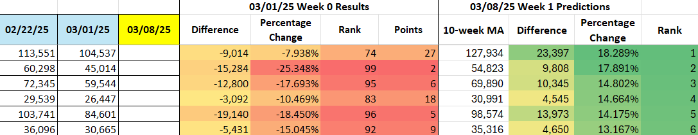
Techniques & analytical methods
Expectation that sales would follow regression to the mean
10-week moving-average of sales
Limit on selecting high sales volume beers
Pick 6 with largest negative distance from average

Slide 5
Week 1 beer selection
Big Sky Moose Drool Brown Ale
Blue Point Toasted Lager
Brooklyn Lager
Points: 55
Times Picked: 1st
Points: 85
Times Picked: 1st
Points: 28
Times Picked: 1st
Lagunitas IPNA Non Alcoholic IPA
Troegs Perpetual IPA
Zero Gravity Conehead IPA
Points: 41
Times Picked: 1st
Points: 99
Times Picked: 1st
Points: 96
Times Picked: 1st
– Made out picks based off of the 6 beers with fewest previous week sales from their averages
Week 1 Total: 404 points (8th)

Slide 6
Week 2 beer selection
Blue Point Toasted Lager
Allagash White Belgian Style Wheat
Big Ditch Hayburner American IPA
Points:70
Times Picked 1st
Points: 82
Times Picked: 1st
Points: 15
Times Picked: 2nd
Gnarly Barley Jucifier OPA
Lagunitas IPNA Non-Alcoholic IPA
Sloop Juice Bomb Northeastern IPA
Points: 88
Times Picked: 1st
Points: 71
Times Picked: 1st
Points: 43
Times Picked: 2nd
What did you learn as weeks progressed?
– Expectation that poor performing beers from last week would regress to the mean.
– Specifically picked Blue Point Toasted Lager again because it still was well below its 10-week average.
Week 2 Total: 369 points (11th)

Slide 7
Week 3 beer selection
Big Sky Moose Drool Brown Ale
Blue Point Toasted Lager
Lagunitas IPNA Non-Alcoholic IPA
Points: 99
Times Picked: 2nd
Points: 72
Times Picked: 3rd
Points: 71
Times Picked: 3rd
Sixpoint Resin Double IPA
Switchback Ale
Wormtown Be Hoppy IPA
Points: 49
Times Picked: 1st
Points: 88
Times Picked: 1st
Points: 97
Times Picked: 1st
Potential concerns grow as Lagunitas Non-Alcoholic and Blue Point Toasted have struggled the last two weeks.
  Decided to pick them anyway
Week 3 Total: 476 points (3rd)

Slide 8
Week 4 beer selection
Breakside IPA
Great North Aleworks IPA
Ithaca Flower Power IPA
Points: 100
Times Picked: 1st
Points: 87
Times Picked: 1st
Points: 99
Times Picked: 1st
Sixpoint Resin Double IPA
Zero Gravity Conehead IPA
Tampa Bay Reef Donkey American Pale Ale
Points: 82
Times Picked: 2nd
Points: 98
Times Picked: 2nd
Points: 90
Times Picked: 1st
Switched out Blue Point Toasted for Tampa Bay Reef Donkey
  Never selected a beer that was top 30 in the previous week. (Rank 29th for Blue Point Toasted in Week 3)
Week 4 Total: 556 points (2nd)

Slide 9
Week 5 beer selection
Heavy Seas Tropicannon
Left Hand Milk Stout Nitro
Marble Double White Ale
Points: 99
Times Picked: 1st
Points: 12
Times Picked: 1st
Points: 96
Times Picked: 1st
Parish Ghost in Machine Ale
Silver City Tropic Haze IPA
Sunriver Vicious Mosquito IPA
Points: 44
Times Picked: 1st
Points: 78
Times Picked: 1st
Points: 46
Times Picked: 1st
- Two extremes present in this week
- First time since Week 1 that all beers were picked for the first time
Week 5 Total: 375 points (9th)

Slide 10
Week 6 beer selection
Belching Beaver Deftones Phantom Bride IPA
Left Hand Milk Stout Nitro
Parish Ghost in Machine Ale
Points: 76
Times Picked: 2nd
Points: 33
Times Picked: 2nd
Points: 37
Times Picked: 1st
Sunriver Vicious Mosquito IPA
Wormtown Be Hoppy IPA
Zero Gravity Conehead IPA
Points: 98
Times Picked: 2nd
Points: 95
Times Picked: 3rd
Points: 55
Times Picked: 2nd
- Method faltered a little this week
- Rebound for Left Hand Milk Stout Nitro
- Back-to-back bad weeks for Parish Ghost in Machine Ale
Week 6 Total: 394 points (9th)

Slide 11
Project grid
Class week: | Game Week 1 | Game Week 2 | Game Week 3 | Game Week 4 | Game Week 5 | Game Week 6
Score update: | 3/11/2025 | 3/18/2025 | 3/25/2025 | 4/1/2025 | 4/8/2025 | 4/15/2025
Player 1 | Big Sky Moose Drool Brown Ale | Allagash White Belgian Style Wheat | Big Sky Moose Drool Brown Ale | Breakside IPA | Heavy Seas Tropicannon | Belching Beaver Deftones Phantom Bride IPA
Player 2 | Blue Point Toasted Lager | Big Ditch Hayburner American IPA | Blue Point Toasted Lager | Great North Aleworks IPA | Left Hand Milk Stout Nitro | Left Hand Milk Stout Nitro
Player 3 | Brooklyn Lager | Blue Point Toasted Lager | Lagunitas IPNA Non-Alcoholic IPA | Ithaca Flower Power IPA | Marble Double White Ale | Parish Ghost In Machine Ale
Player 4 | Lagunitas IPNA Non-Alcoholic IPA | Gnarly Barley Jucifer IPA | Sixpoint Resin Double IPA | Sixpoint Resin Double IPA | Parish Ghost In Machine Ale | Sunriver Vicious Mosquito India Pale Ale
Player 5 | Troegs Perpetual IPA | Lagunitas IPNA Non-Alcoholic IPA | Switchback Ale | Tampa Bay Reef Donkey American Pale Ale | Silver City Tropic Haze India Pale Ale | Wormtown Be Hoppy IPA
Player 6 | Zero Gravity Conehead IPA | Sloop Juice Bomb Northeastern IPA | Wormtown Be Hoppy IPA | Zero Gravity Conehead IPA | Sunriver Vicious Mosquito India Pale Ale | Zero Gravity Conehead IPA
Week Score: | 404 (8th) | 369 (11th) ⇩ | 476 (3rd) ⇧⇧ | 556 (2nd) ⇧⇧ | 375 (9th) ⇩⇩ | 394 (9th) ⇧
Cumulative Score: | 404 | 773 | 1,249 | 1,805 | 2,180 | 2,574

Slide 12
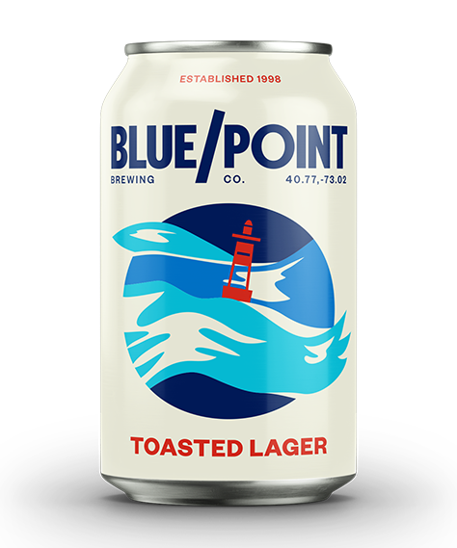
One beer we regret picking
Blue Point Toasted Lager
Picked each of first three weeks
  Week 1: 28 Points
  Week 2: 15 Points
  Week 3: 72 Points
- While we felt that our strategy was good, there is still some chance for general unpredictability in beer sales
- We picked each week assuming that it would return to the average
- If redone we would consider picking in Week 3, but not weeks 1 and 2
- In the future, we could check more for trends of rising or falling in the very recent weeks

Slide 13

Conclusion
Finishing position: 5th Place - 2,574 points
Highest scoring week: Week 4 - 556 points
Lowest scoring week: Week 2 - 369 points
Final remarks:
Two great weeks in Week 3 and 4
Weeks 5 and 6 our method seemed to struggle

Slide 14
Thanks!
Do you have any questions?
Please keep this slide for attribution

